Slide 1
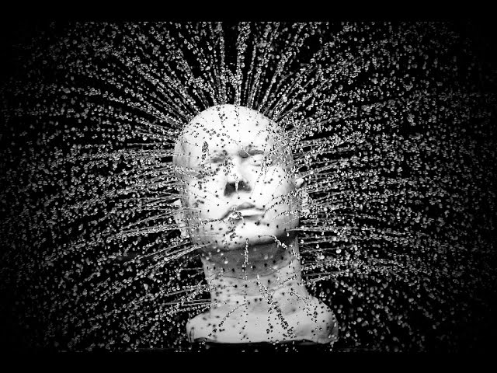
Externalism
Kareem Khalifa
Philosophy Department
Middlebury College

Slide 2
Overview
1. Motivation
2. Reliabilism
3. Probabilism

Slide 3
1. Motivation
1.1. The distinction
1.2. Why externalism?

Slide 4
2. Reliabilism: Overview
2.1. Goldman’s theory
2.2. Problems

Slide 5
2.1. Goldman’s theory

Slide 6
2.2. Problems with reliabilism
2.2.1. New evil demon
2.2.2. Clairvoyance
2.2.3. Generality

Slide 7
3. Probabilism: Overview
3.1. Simple Bayesianism
3.2. Subjective probability
3.3. General problems with probabilism

Slide 8
3.1. Simple Bayesianism
Bayes’ Theorem:
prob(h|e) =
prob(e|h) *prob(h)/ prob(e)

Slide 9
3.2. Subjective probability
Degrees of belief: Suppose that you would only bet on an event e if you would receive $3 for every $1 you wagered. Then degree of belief in e = prob(e) = 3/(3+1) = ¾.
Notes:
How do we measure degrees of belief? A crucial function of belief is how it figures in our behavior. We can see every intentional behavior as a kind of bet. For instance, when I intend to make coffee by pushing the appropriate buttons on the coffee maker, I’m basing my future actions on this being an effective action. But to base one’s future actions on this way is to act just like a bettor: one is doing something with the expectation of certain kinds of returns. So, we can view each action as a bet. This means that we can construe degrees of belief as betting odds. To assign a probability of 0.75 to the coffee maker working means that I would only bet against the coffee maker working if I were given $3 on a $1 bet (3:1 betting odds.)

Slide 10
3.2. Subjective probability
Linda is 31 years old, single, outspoken, and very bright. She majored in philosophy. As a student, she was deeply concerned with issues of discrimination and social justice, and also participated in anti-nuclear demonstrations.
Which of the following two alternatives is more probable?
1. Linda is a bank teller.
2. Linda is a bank teller and active in the feminist movement.
3.2.1. Descriptive subjectivism
Notes:
How do we measure degrees of belief? A crucial function of belief is how it figures in our behavior. We can see every intentional behavior as a kind of bet. For instance, when I intend to make coffee by pushing the appropriate buttons on the coffee maker, I’m basing my future actions on this being an effective action. But to base one’s future actions on this way is to act just like a bettor: one is doing something with the expectation of certain kinds of returns. So, we can view each action as a bet. This means that we can construe degrees of belief as betting odds. To assign a probability of 0.75 to the coffee maker working means that I would only bet against the coffee maker working if I were given $3 on a $1 bet (3:1 betting odds.)

Slide 11
3.2. Subjective probability
3.2.2. Dutch Book Arguments
3.2.3. Objections
Notes:
How do we measure degrees of belief? A crucial function of belief is how it figures in our behavior. We can see every intentional behavior as a kind of bet. For instance, when I intend to make coffee by pushing the appropriate buttons on the coffee maker, I’m basing my future actions on this being an effective action. But to base one’s future actions on this way is to act just like a bettor: one is doing something with the expectation of certain kinds of returns. So, we can view each action as a bet. This means that we can construe degrees of belief as betting odds. To assign a probability of 0.75 to the coffee maker working means that I would only bet against the coffee maker working if I were given $3 on a $1 bet (3:1 betting odds.)

Slide 12
3.3. Problems with probabilism
3.3.1. Tautologies
3.3.2. Self-defeat

